Slide 1


Machine Learning for Demand Forecasting of Steel Products in the Automotive Industry
A Tata Steel Case Study: Improving Demand Forecasts in a Dynamic Market Environment
A Thesis for the MSc Econometrics, Operations Research and Actuarial Studies, track Econometrics
Faculty of Economics and Business, University of Groningen, January 22, 2024.
Freek Merijn Hobbenschot – S3428397

Slide 2

Agenda
Theoretical Background
Literature Review
Data
Target Variables
Available Features
Data Processing
Feature Selection Methods
Methodology
Results and Analysis
Recap and Conclusion
Limitations and Recommendations

Slide 3
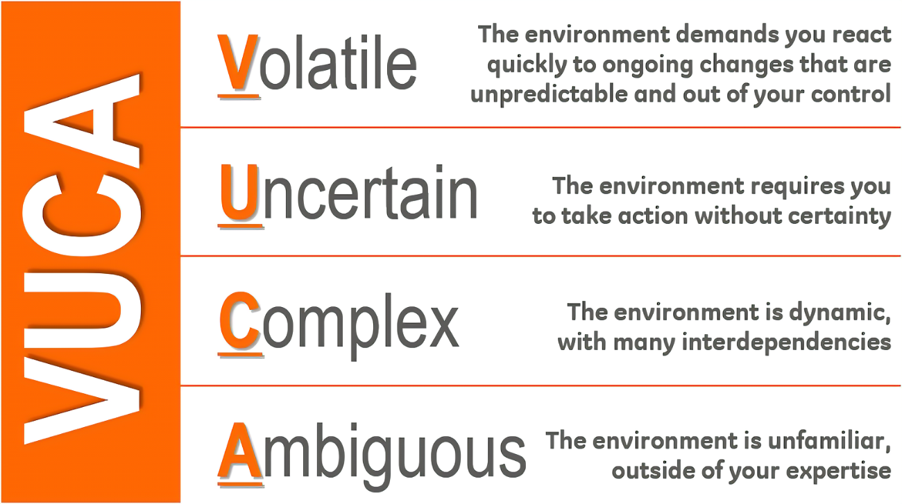
Theoretical Background
Steel Industry and Tata Steel
Automotive, Engineering, Packaging, Construction markets
Consumer-, distribution- and economically- driven markets
Current demand models are based on traditional market cycles
Used for tactical and strategical sales plans
Geo-Political Developments (Coal and Electricity)
Sales contracts (Volume and Order Book)
Decarbonization
Dealing in a VUCA World, Hattangadi, V. (2022)

Slide 4
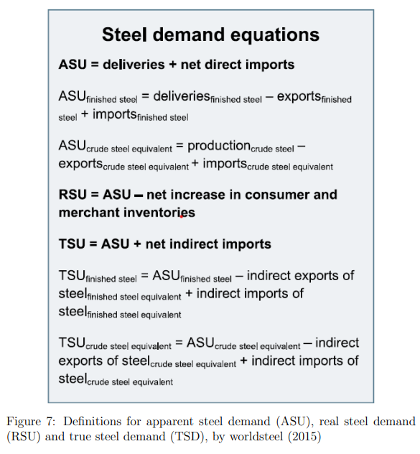
Theoretical Background
Apparent demand represents the visible consumption in the market as seen from a steel-making viewpoint
Real demand accounts for changes in inventory levels; the demand from a manufacturer viewpoint
True demand reflects the essential demand for steel, including net imports from non-target markets; consumer viewpoint

Slide 5
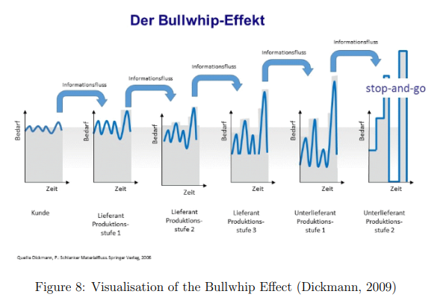
Theoretical Background
Difficulty to align production with demand
Lack of information from stakeholders and their inventories
Fluctuations have effect on order book decisions
Steel-making is an ongoing process
High fixed costs, low profit margins
Continues order flow and full production capacity

Slide 6
Literature Review
Traditional and modern demand models
Econometric Demand Models and VAR (macro-economic)
Intensity of Use Models (macro-economic)
SWIP Models (industrial performance)
SWIP derives apparent steel demand from real steel demand and product demand from total demand
Based on traditional market cycles and assumptions on inventory levels
Frequent revisions in demand forecasts (Eurofer, 2023)
Hybrid Demand Models and Machine Learning
Grey models (Evans, 2014), Fuzzy-Arima models (Torbat et al. 2018)
Complex for non-specialists to understand and use

Slide 7
Data - Target Variables
Target Variables
Hot Rolled Narrow Strip: Commonly used in the automotive industry for various structural components in vehicles
Lengths Cut From Hot Rolled Wide: Commonly used for manufacturing automotive components that require wider and thicker steel sheets, such as vehicle frames
Cold Rolled Sheets: Characterized by a smooth surface finish and often used for exterior parts such as door panels and hoods
Hot Dipped Metal Coated Sheets: Commonly used for parts that require heavy resistance for corrasion, such as undercarriage components
Electrolytically Metal Coated Sheets: Commonly used for parts that require high-quality surface finish as well as moderate corrosion resistance. This can range from interior to exterior components.
Grain Non-Oriented: Commonly used for electrical components, such as the motors and transformers in vehicles.

Slide 8

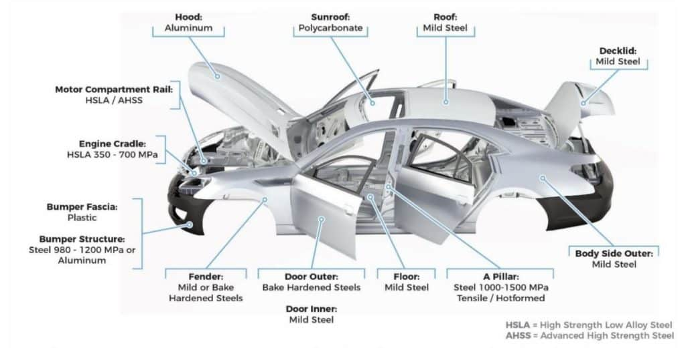
Data – Target Variables
LA Hal Velsen-Noord (Nationale Staalprijs, 2024)
Car Manufacturing Process (Hashmicro, 2024)

Slide 9
Data – Available Features
27 macro-economic and industrial indicators
Based on domain knowledge from industrial experts
Related to the target variables (no irrelevant features)
Monthly data retrieved via Refinitiv from multiple sources
Practical considerations: monthly data (no interpolation)
Economic Performance Indicators
Purchasing Managers’ Index (PMI)
Confidence and Sentiment Indicators
Price and Market Indicators

Slide 10
Data – Available Features
Economic Performance Indicators | Source
IP Total | Eurostat
IP Manufacturing | Eurostat
GVA Automotive | Eurostat
GVA Construction | Eurostat
GVA Machinery | Eurostat
Number of Cars Produced in EU27 | Wards
Number of Cars Produced in Germany | VDA

Slide 11
Data – Available Features
Purchasing Managers’ Indices | Source
Manufacturing PMI - Output | S&P
Manufacturing PMI – New Orders | S&P
Manufacturing PMI – Input Prices | S&P
Manufacturing PMI – Output Prices | S&P
Construction PMI | S&P
Services PMI | S&P

Slide 12
Data – Available Features
Economic Performance Indicators | Source
Economic Sentiment Indicator Volatility | DG ECFIN
Overall Industrial Confidence Indicator | DG ECFIN
Services Confidence Indicator – Total | DG ECFIN
Consumer Confidence Indicator – EU | DG ECFIN
Retail Trade Confidence Indicator – Overall | DG ECFIN
Construction Confidence Indicator – Overall | DG ECFIN
Industrial Confidence Indicator (Motors & Trailers) | DG ECFIN
Industrial Confidence Indicator (Machinery & Equipment) | DG ECFIN

Slide 13
Data – Available Features
Price and Market Indicators | Source
CPI (Consumer Price Index) | Eurostat
PPI (Producer Price Index) | Eurostat
Unemployment Rate | Eurostat
US Dollar to Euro Exchange Rate | Refinitiv
Yield on Ten-Year Government Bonds | ECB
Euro Internbank Offered Rate | EBF

Slide 14
Data – Data Processing
Cleaning and Preparing
Data covers April 2008 till January 2023, retrieved in September 2023
No publication lags or data revisions (e.g. for macro-economic indicators GDP, GVA)
No incorrect or missing values
Splitting data
Removing trends, differencing
Test for stationary
Kwiatkowski-Phillips-Schmidt-Shin (KPSS) test and Dickey-Fuller (DF) test
Perform power transformation to improve data characteristics (distribution)
Perform scaling to prevent magnitude issues
Yeo-Johnson power transformation with implicit data standardization (Raju et al. (2022)

Slide 15
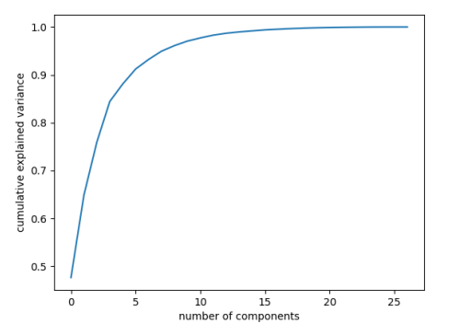
Data – Feature Selection
PCA
Dimensionality Reduction
Principle components (linear combinations) explain variance in the data
For each of the X linear combinations, take the feature with highest impact
Used by Raju et al. (2021)

Slide 16
Data – Feature Selection
Target Based Feature Selection
Wrapper and Filter methods
Recursive Feature Elimination with Cross Validation (Wrapper) (next slide)
Cross-Validation: more robust and less sensitive to underlying time-trends
Fit both a Linear Regression and Gradient Boosting model
For each target variable, three different ‘best’ sets with features:
PCA, RFE-CV with Linear Regression and RFE-CV with Gradient Boosting

Slide 17
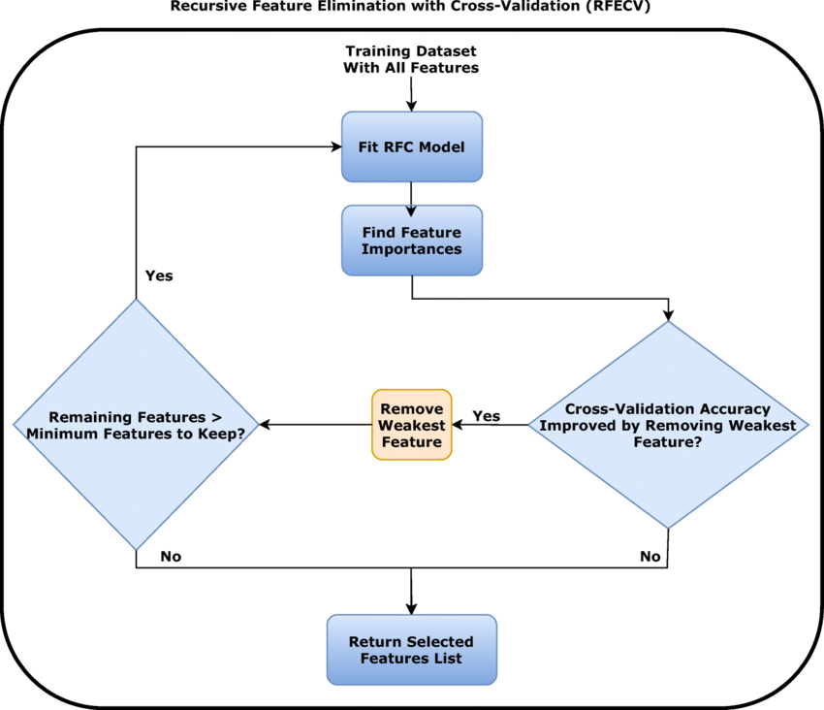
Data – Feature Selection
Feature fusion based machine learning pipiline, Mishra et al. 2022

Slide 18
Methodology
Long Short-Term Memory Model
Economic Nowcasting with Long Short-Term Memory Artificial Neural Networks (LSTM) (Hopp, 2021)
United Nations – Conference on Trade and Development
Type of Artificial Neural Network (Deeplearning)
ANNs’ robustness to multicollinearity (De Veaux and Ungar, 1994) make feature reduction methods less necessary
Lstm_nowcast library in python
Compared with Dynamic Factor Models
Advantages: handling large numbers of input features (also with different time frequencies)
Disadvantage: no causal relationships (contribution of features)

Slide 19
Methodology
Long Short-Term Memory Model
Hyperparameters
Layers (input, hidden, output): sets of neurons, more layers for more complex structures
Neurons: responsible from learning and capturing patterns from sequential data
Time-steps: represent the length of sequences [M1,M2,M3,M4,M5] (computationally intensive)
Batches: subsets of data, after processing the model gets updated
Training epochs: number of times the model will be exposed to the entire data set (under-, overfitting)
Drop-out rate: fraction of the batch that is not included, to prevent overfitting
Adam optimizer with grid search to determine the best set of hyperparameters

Slide 20
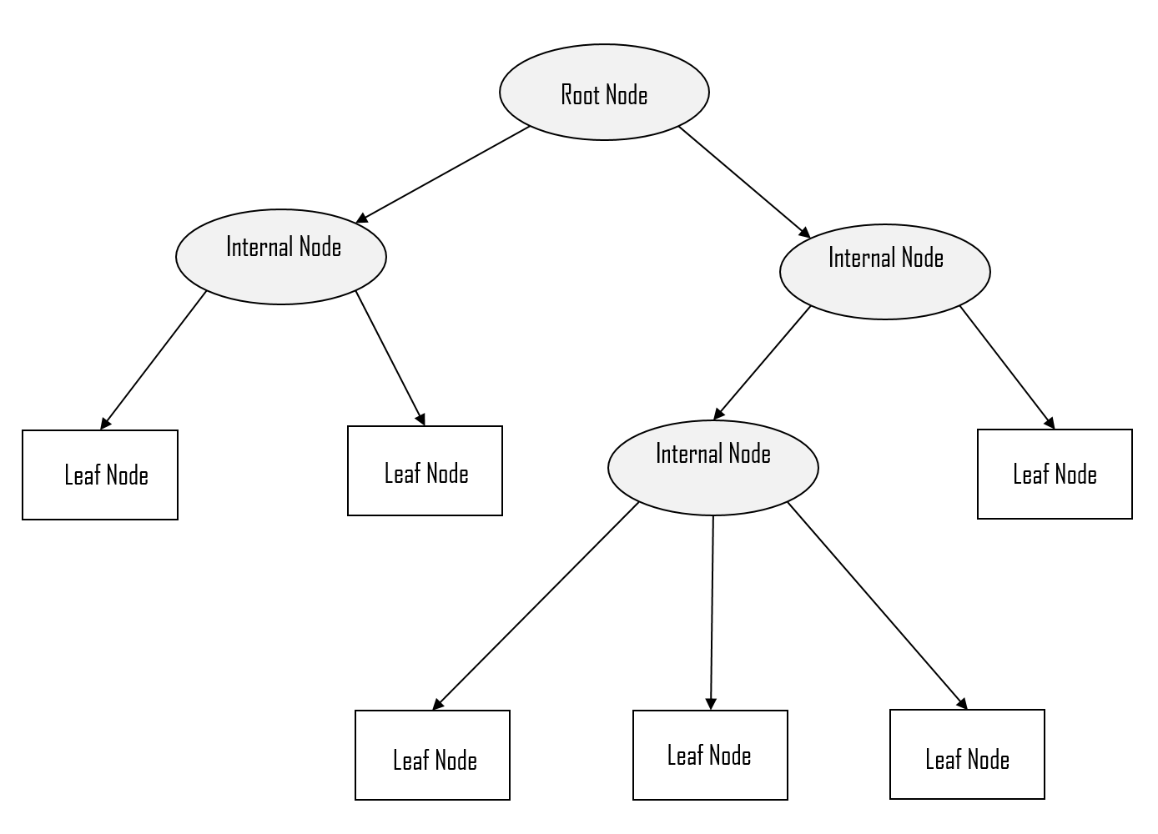
Methodology
Random Forest Regression (Raju et al.)
Scikit-learn’s RandomForestRegressor
Ensemble technique, based on decision trees (bagging)
Hyperparameters
Number of decision trees
Maximum number of features considered for splitting a node
Maximum depth: number of levels in each decision tree
Minimum number of data points placed in a node before splitting
Minimum number of data points allowed in a leaf (end) node
Bootstrap (with or without replacement)

Slide 21
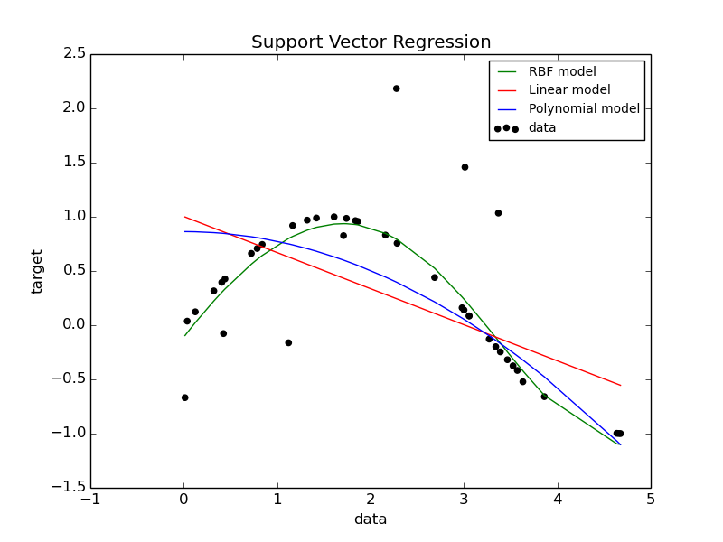
Methodology
Support Vector Regression (Raju et al.)
Find a hyperplane that best fits the training data within a certain error margin
Hyperparameters:
Kernel function; linear, polynomial, gaussian, sigmoid. radial basis function
Regularization parameter C (cost): determines the trade-off between fitting the training data and having a smooth decision boundary. (higher C allows the model to fit more closely, but might result in overfitting)
Epsilon determines the allowed error margin: if the difference between real and expected value is higher than epsilon, it results in a penalty as given by the loss function
Gamma: determine the influence of a single training sample:
A higher gamma makes the decision boundary more complex and flexible
allowing the model to closely fit the data.

Slide 22
Methodology
Ensemble model 1
Combines Random Forest Regression and Support Vector Regression
Simple average
Mitigate impact of biases or poor performance of single models
Less likely to overfit
Improves ability to generalize well to unseen data

Slide 23
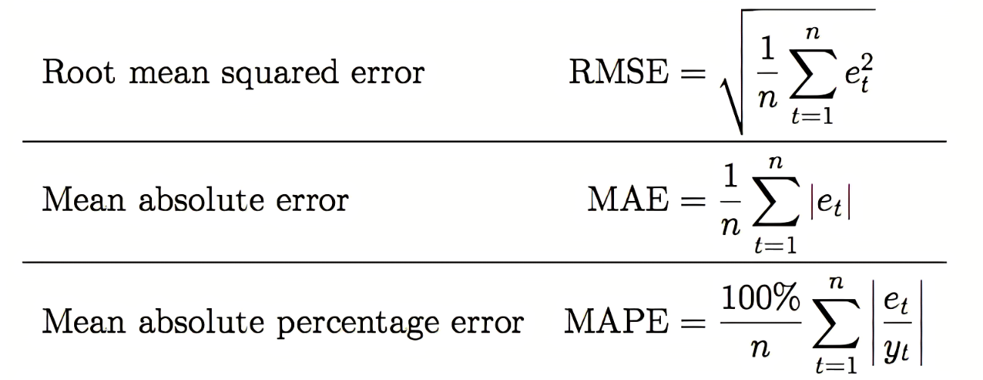
Methodology
Performance Metrics
Root Mean Squared Error: overall accuracy, penalizing larger errors more heavily
Mean Absolute Error: measure of absolute error, without the influence of squared terms
Mean Absolute Percentage Error: express errors as percentage of actual values, making it useful for understanding the relative magnitude of errors

Slide 24
Results and Analysis
Hot Rolled Narrow Strip
Number of Cars Produced in EU
PPI
Industrial Confidence Indicator - Machinery and Equipment
GVA Machinery
CPI
Consumer Confidence Indicator – EU
Unemployment Rate
Manufacturing PMI - Input Prices

Slide 25
Results and Analysis
Length Cut From Hot Rolled Wide
Number of Cars Produced in EU
Industrial Confidence Indicator - Machinery and Equipment
Manufacturing PMI - new orders
Manufacturing PMI – Output
Industrial Confidence Indicator - Motor Vehicles, Trailers & Semi-Trailers
Economic Sentiment Indicator Volatility
Overall Industrial Confidence Indicator
Retail Trade Confidence Indicator - Overall

Slide 26
Results and Analysis
Cold Rolled Sheets
Construction PMI
GVA automotive
Services PMI
Number of Cars Produced in EU
Overall Industrial Confidence Indicator
Manufacturing PMI - Input Prices
Unemployment Rate
Manufacturing PMI - New Orders

Slide 27
Results and Analysis
Hot Dipped Metal Coated Sheets
Industrial Confidence Indicator - Motor Vehicles, Trailers and Semi-Trailers
Number of Cars Produced in Europe
Construction Confidence Indicator – Overall
Manufacturing PMI - New Orders
Manufacturing PMI – Output
Number of Cars Produced in Germany
Unemployment Rate
Euribor

Slide 28
Results and Analysis
Electrolytically Metal Coated Sheets
Number of cars produced in EU
Number of Cars Produced in Germany
Manufacturing PMI - New Orders
Euribor
Services PMI
Overall Industrial Confidence Indicator
Economic Sentiment Indicator Volatility
Industrial Confidence Indicator - Machinery and Equipment

Slide 29
Results and Analysis
Grain Non-Oriented
Retail Trade Confidence Indicator – Overall
Manufacturing PMI - Input Prices
Number of Cars Produced in EU
Construction PMI
CPI
GVA Construction
Industrial Confidence Indicator - Motor Vehicles, Trailers and Semi-Trailers
Manufacturing PMI - New Orders

Slide 30
Results and Analysis
Feature selection
‘Number of cars produced in the EU’ appears in the feature selection for all different steel products
Purchasing Managers’ Indices (PMI) appear frequently (leading indicators)
Confidence and Sentiment Indicators appear frequently (leading indicators)
Price and Market Indicators appear less frequently, only the unemployment rate and Euribor are used multiple times
Unemployment rate reflects (past) labor market conditions and economic performance. Changes follow broader economic trends.
Euribor provides information on lending rates. Changes in Euribor can impact borrowing costs, which affects economic activity.

Slide 31
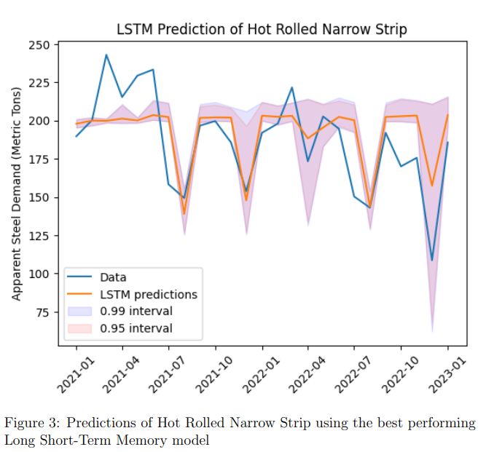
Results and Analysis

Slide 32
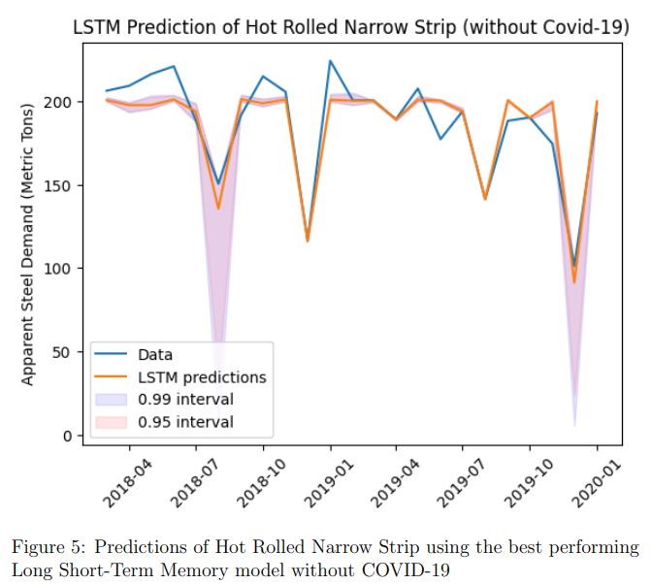
Results and Analysis

Slide 33
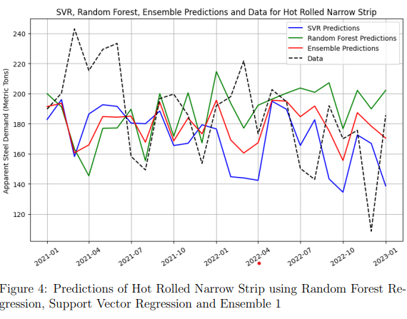
Results and Analysis

Slide 34
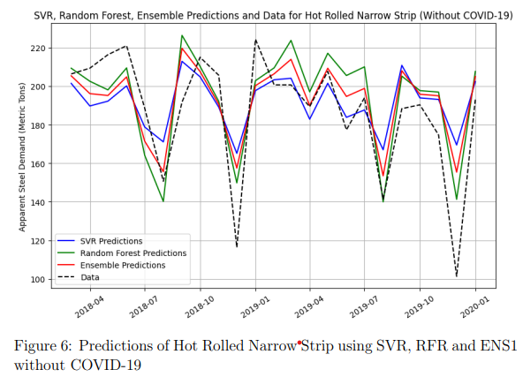
Results and Analysis

Slide 35
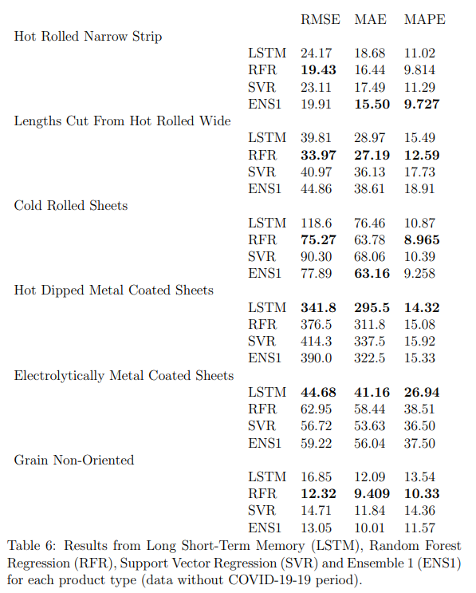
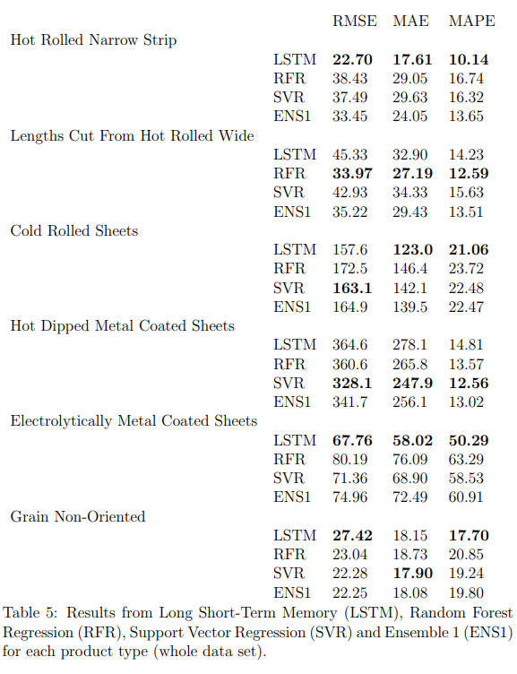
Results and Analysis

Slide 36
Results and Analysis

Slide 37
Results and Analysis
Including the Covid-19 period
For both Hot Rolled Narrow Strip and Electrolytically Metal Coated Sheets the LSTM model performs better than the other models across all performance metrics.
For Lengths Cut From Hot Rolled Wide the Random Forest Regression model performs better than the other models across all performance metrics.
For Hot Dipped Metal Coated Sheets the Support Vector Regression model performs better than the other models across all performance metrics.
For Cold Rolled Sheets, the LSTM model has the best (lowest) MAE and MAPE, while the Support Vector Regression model has the best RMSE.
For Grain Non-Oriented the LSTM model has the best RMSE and MAPE, while the Support Vector Regression model has the best MAE.

Slide 38
Results and Analysis
Excluding the Covid-19 period
For both Lengths Cut From Hot Rolled Wide and Grain Non-Oriented the Random Forest Regression model performs better than the other model across all three performance metrics.
For both Hot Dipped Metal Coated Sheets and Electrolytically Metal Coated Sheets the LSTM model performs better than the other models across all three performance metrics.
For Hot Rolled Narrow Strip the Random Forest Regression model has the best RMSE, while the ENS1 model has the best MAE and MAPE.
For Cold Rolled Sheets the Random Forest Regression model has the best RMSE and MAPE, while the ENS1 model has the best MAE.
Model performance highly dependent on underlying data
Better results compared to the models that include the Covid-19 period

Slide 39
Recap and conclusion
Steel demand in the automotive industry and EU 27 region
Six steel products and a variety of features, based on discussions with industrial experts
Data is processed using differencing techniques (stationarity).
Dickey-Fuller and Kwiatkowski-Phillips-Schmidt-Shin (KPSS) test are used to test for stationarity
Yeo-Johnson and standardization to account for differences in scale sizes and other technicalities
Tree different performance metrics: RMSE, MAE and MAPE
Excluding the COVID-19 period, both LSTM and Random Forest Regression perform well compared to Support Vector Regression and Ensemble 1
Including the COVID-19 period, the differences across models were larger
Relatively high errors, even the best models were not precise
Steel-making companies should not rely on one single model

Slide 40
Limitations and Recommendations
Exploring different transformation and scaling techniques (Box-Cox, min-max)
Including extra features, alternative feature selection techniques (model specific)
Quarterly and yearly features (using interpolation techniques)
Integrate external forecasts (GDP)
Including publications lags and accounting for data revisions
Alternative methods to conduct hyperparameter tuning (random search)
Patterns between steel products
Other machine learning models (N-Beats, Facebook Prophet, Neural Prophet)
Other ensemble models (LSTM with traditional less data-hungry models)
Fuzzy Neural Networks with ARIMA
Handling extreme event, how to account for COVID-19?

Slide 41
Do you have any questions?

Slide 42

Section 1 header (Arial, Bold 40pt)
Subtitle section (Arial 20pt)

